Slide 1


Annual energy usage and annual energy cost calculations
Electric Power Load Analysis (EPLA)
Revision of 8 August 2026
Dr. Norbert Doerry
http://doerry.org/norbert/MarineElectricalPowerSystems/index.htm
© 2026 by Norbert Doerry
This work is licensed via: CC BY 4.0 (https://creativecommons.org/)

Slide 2
Essential Questions
What information is needed to perform an Annual Energy Usage and Annual Energy Cost Calculation? | Understand
How does one obtain the information needed to perform an Annual Energy Usage and Annual Energy Cost Calculation? | Understand
What are the results of an Annual Energy Usage and Annual Energy Cost Calculation used for? | Understand
How is an Annual Energy Usage and Annual Energy Cost Calculation performed? | Apply

Slide 3
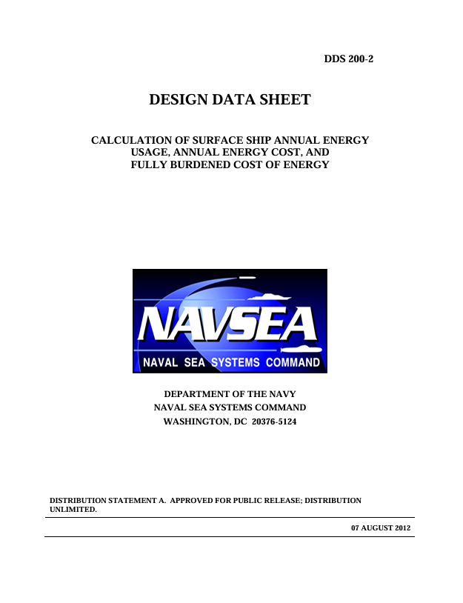
Introduction
Annual energy consumption estimates used to
  Calculate Total Ownership Cost
    Used to trade off different design options
    Used in return on investment (ROI) calculations
  Develop budgets for fuel
  Derive requirements for underway replenishment ships
Lifecycle cost of energy is a function of:
  Operational profile development
  Annual energy usage calculation
  Fully Burdened Cost of Energy calculation
DPC 200-2 focused on naval ships, but may be adapted to commercial ships

Slide 4
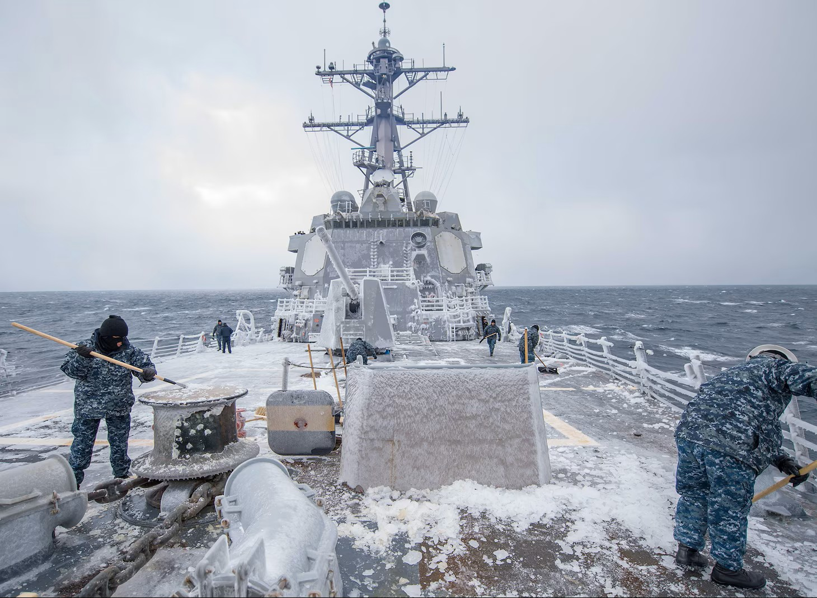
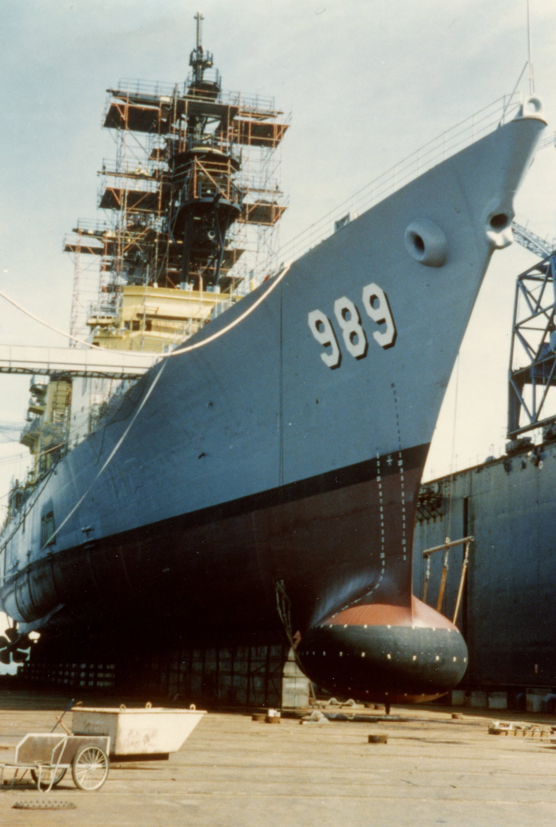
Operational Profile
Image is in the Public Domain
Operational profile describes the number of hours a ship operates
  For each year of the ship’s design life
  In each of its operational modes and associated speed-percent time profiles
In early stages of design, the operational profile may be assumed to be the same for each year.
As the design progresses, the operational profile may not be the same year to year based on
  Expected employment of the ship
  Maintenance and modernization strategy
(C) Copyright 1985 by Norbert Doerry; licensed via CC BY 4.0

Slide 5
Operational Profile products
Table of “ship states”
  Ship states reflect a level of capability for the ship
  Normally includes the operational conditions used for the EPLA
  More ship states may be defined if required
Operational modes list
  Operational modes describe the capability sets a ship must support for a given period of time (generally at least a month)
  Capture full range of ship activities over its service life in a relatively few number of categories
Ship state participation Table
  Fraction of time (participation factor) spent in each ship state for each operational mode
Ship deployment and employment profiles
  For each year in the ship’s service life, records the fraction of time (or number of hours) the ship is estimated to be in each of the operational modes
  Multiple ship deployment and employment profiles may be created to span the range of possible alternate futures
    Can be used as the basis for real options analysis

Slide 6
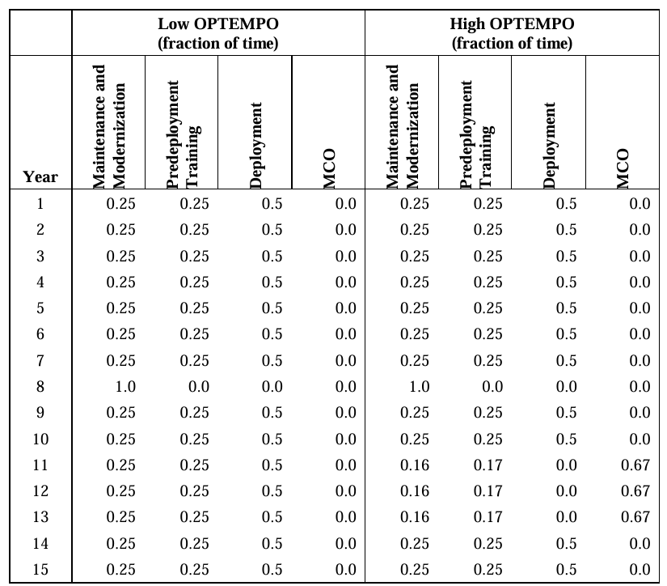
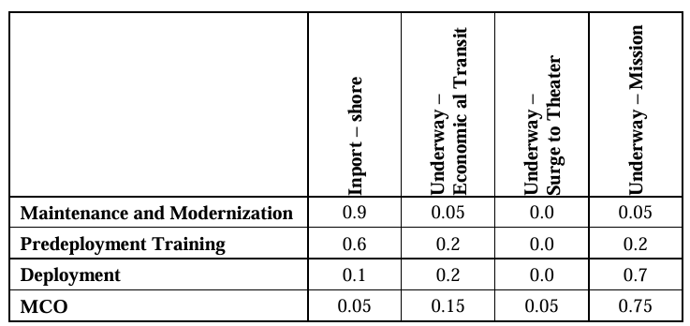
Operational Profile Example (DPC 200-2)
Ship states
Ship deployment and employment profiles
Ship state participation Table
Operational Modes
Participation Factors
MCO = Major Combat Operations

Slide 7
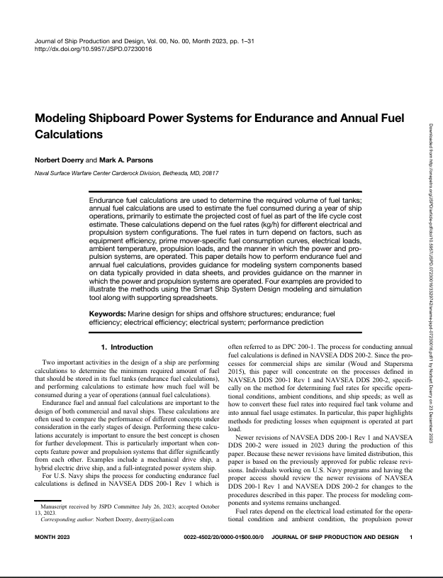
Annual Energy Usage
Calculates energy usage table for each ship deployment and employment profile:
  Fuel consumed in kg
  Shore power in kW-h
Fuel consumed by ship
  Use methods detailed in DPC 200-1 and Doerry & Parsons (2023) to calculate fuel rate (kg/h) for each ship state.
  Use Ship State Participation Table to calculate the fuel rate (kg/h) for each operational mode
  Use Ship Deployment and Employment Profile to calculate the fuel (kg) consumed each year and over the ship’s service life.
Shore power in kW-h
  Estimate shore power for each ship state (kW)
  Use ship state participation table to calculate average shore power for each operational mode (kW)
  Use Ship Deployment and Employment Profile to calculate the Shore Power (kW-h) energy consumption consumed each year and over the ship’s service life.

Slide 8
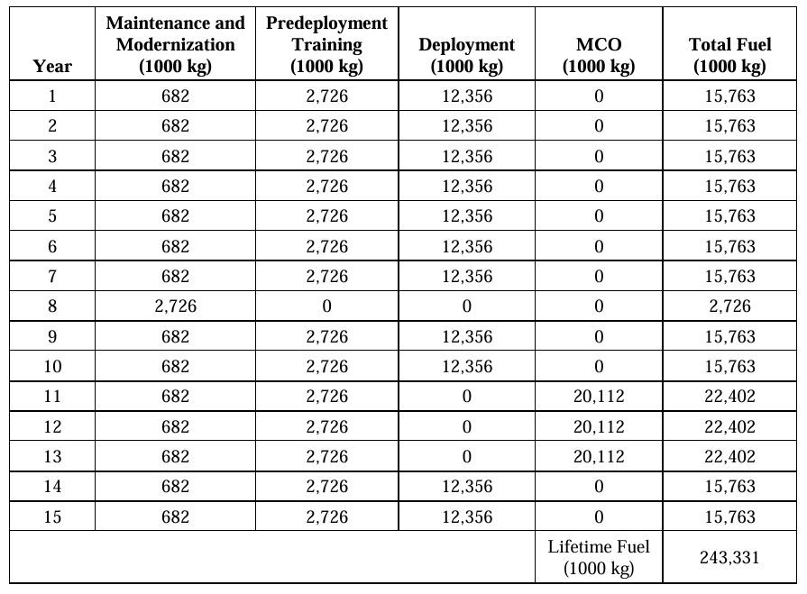
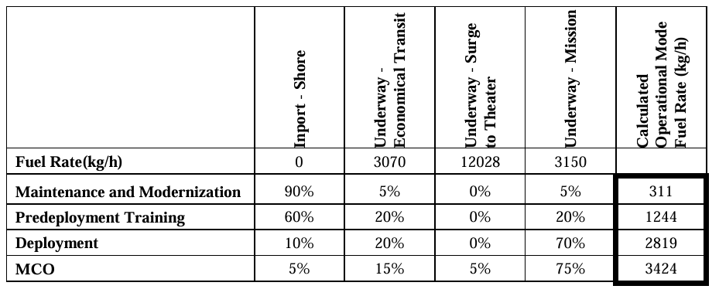
Annual Energy Use (fuel) example
(DPC 200-2)
Ship states
Annual Energy Use (fuel) for Hi OPTEMPO
Operational Modes
Multiply operational mode fuel rate by hours in operational mode each year

Slide 9
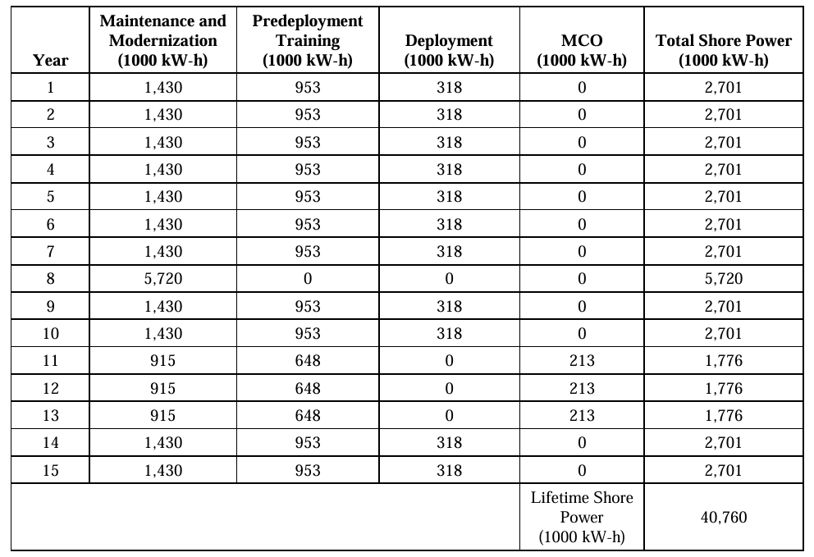
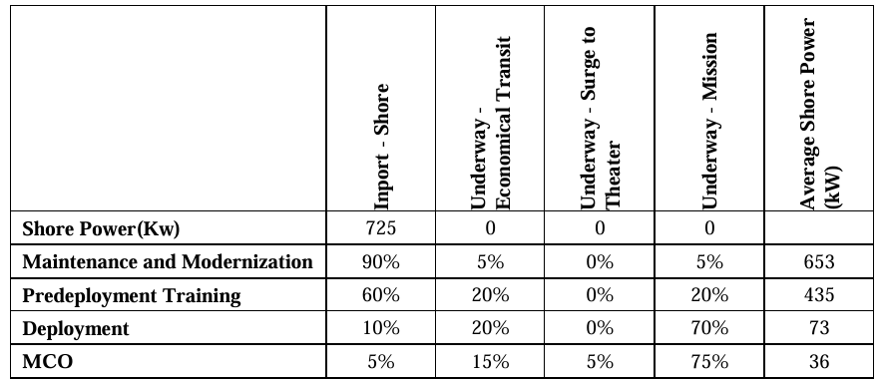
Annual Energy Use (Shore Power) example (DDS 200-2)
Annual Energy Use (shore power) for Hi OPTEMPO

Slide 10
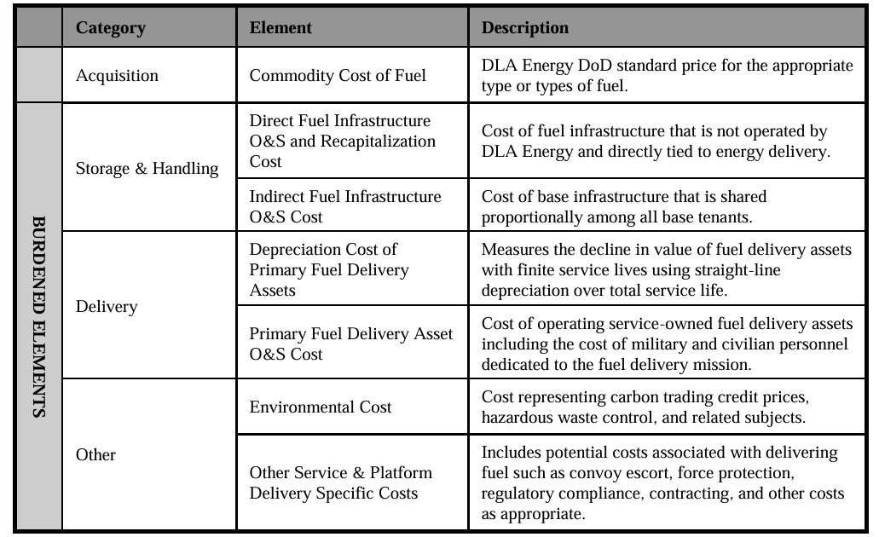
Fully Burdened Cost of Energy
Cost structure of Navy Fuel
The cost of fuel includes
  Acquisition cost
  Storage and handling cost
  Delivery cost
  Other cost
All cost elements have uncertainty
Costs can vary substantially year to year
  Hard to predict
  Should examine ranges of costs to understand design robustness
    Low – Mid – High
    For each year

Slide 11
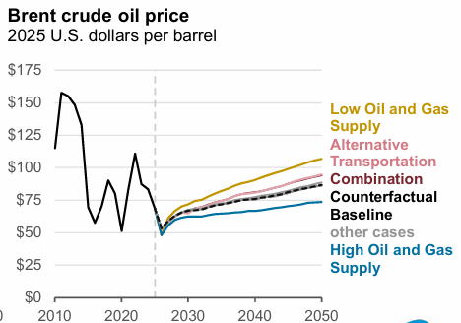
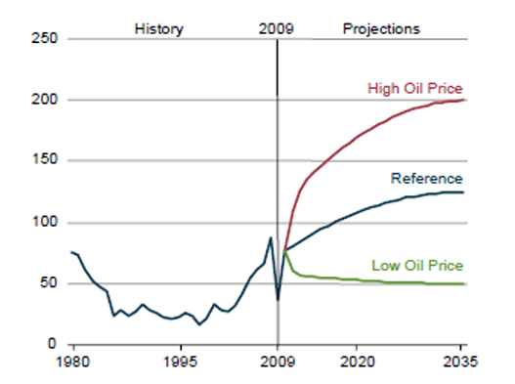
Predicting crude oil price is difficult
Annual Energy Outlook 2011
Annual Energy Outlook 2025
$382.5 (2025)
$306 (2025)
$229.5 (2025)
$153 (2025)
$76.5 (2025)
$1.00 in 2009 = $1.53 in 2025
Annual Energy Outlook is produced by the
U.S. Energy Information Administration
https://www.eia.gov/

Slide 12
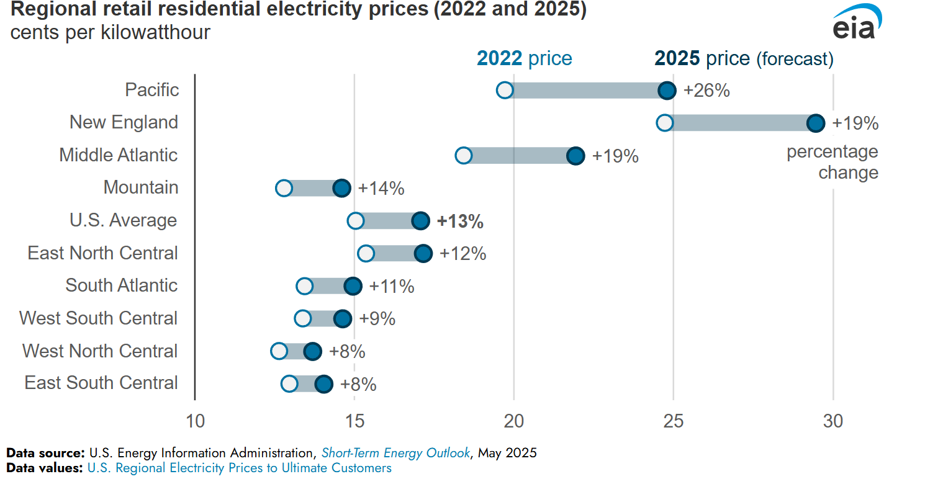
Cost of Shore Power
U.S. Energy Information Agency (https://www.eia.gov) provides rate information for electrical power
Varies significantly by geographic region.
Price of electricity is anticipated to grow about 4% per year for near future.
  Slightly higher than the forecast growth in CPI
Should estimate a low, mid, and high cost of shore power ($ per kW-h) for each year based on projections.

Slide 13
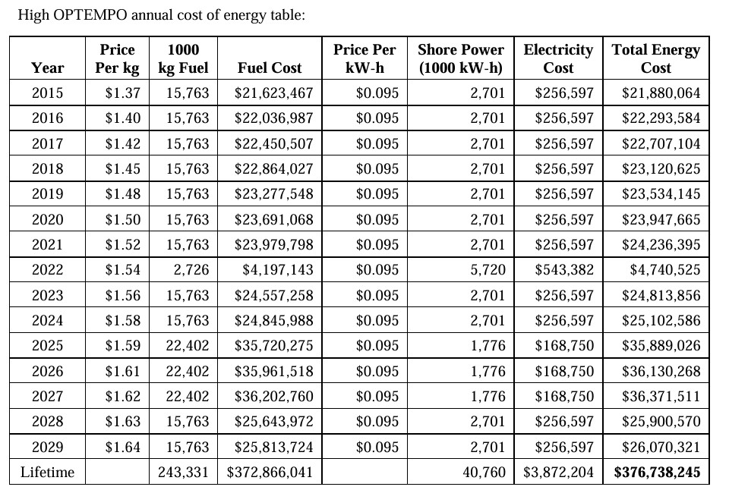
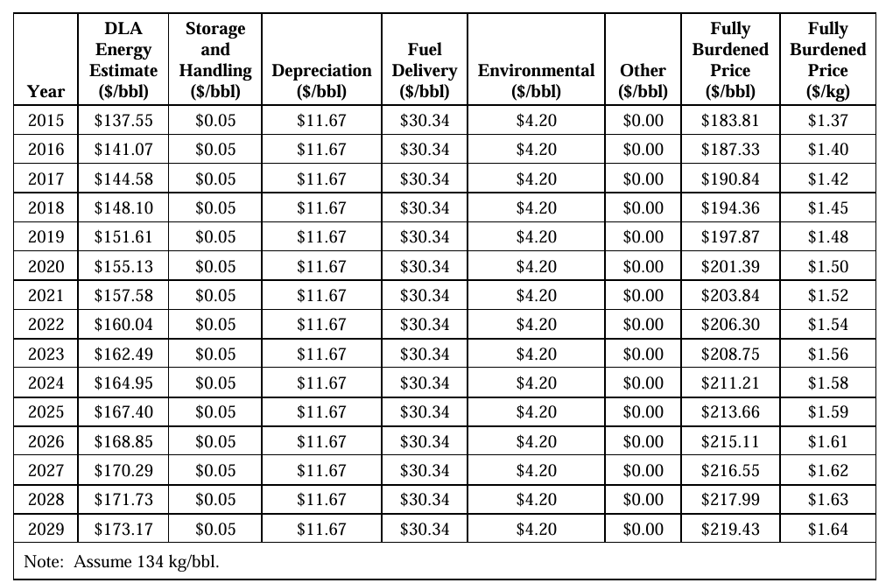
Annual Energy Cost Calculations
Apply the range of energy costs to the energy usage predictions of each ship deployment and employment profile

